Slide 1

Resumate
Week-4 Group-7
Saud| Anika| Sakia | Rima
North South University | 2025

Slide 2
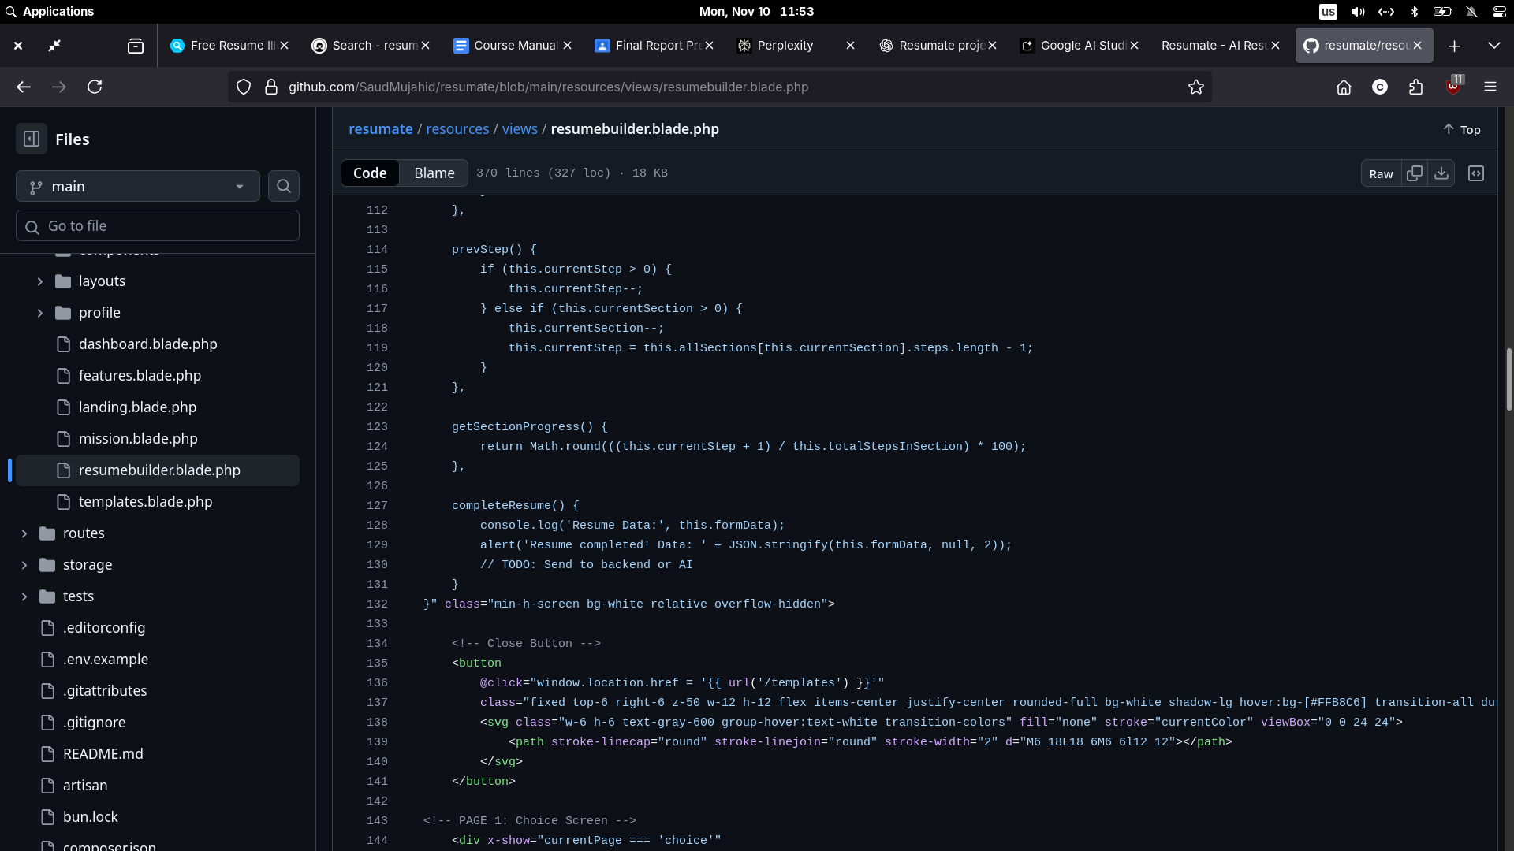
1
Previous progress

Slide 3
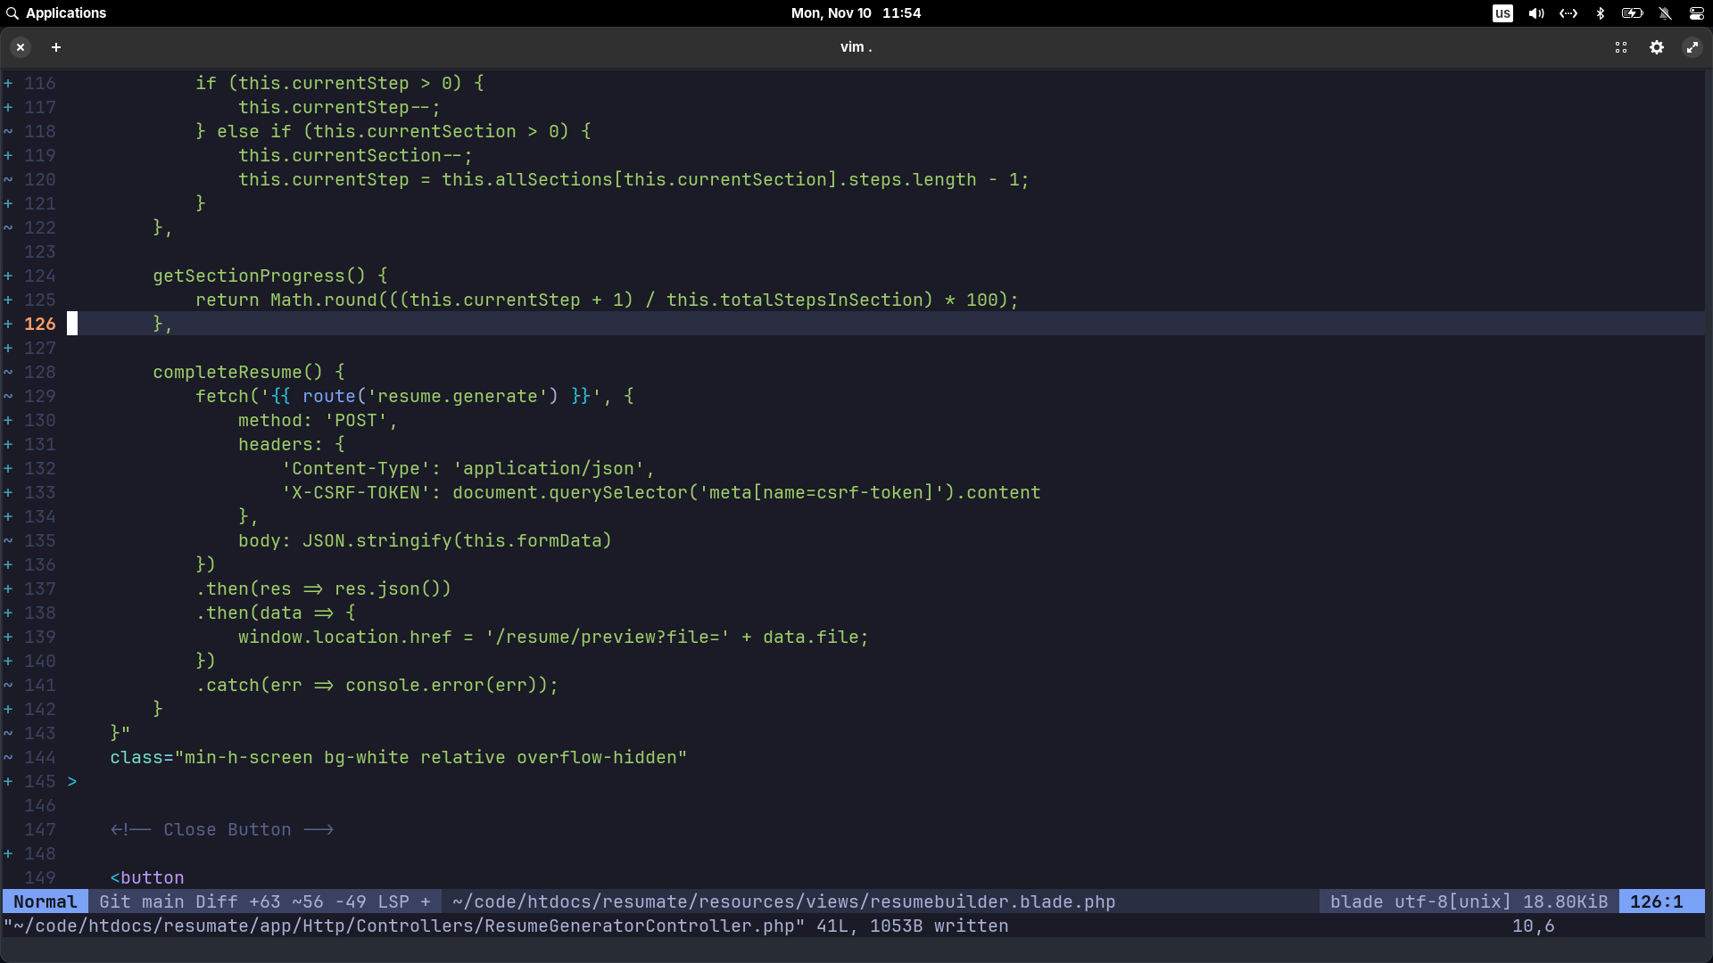
1
Progress

Slide 4
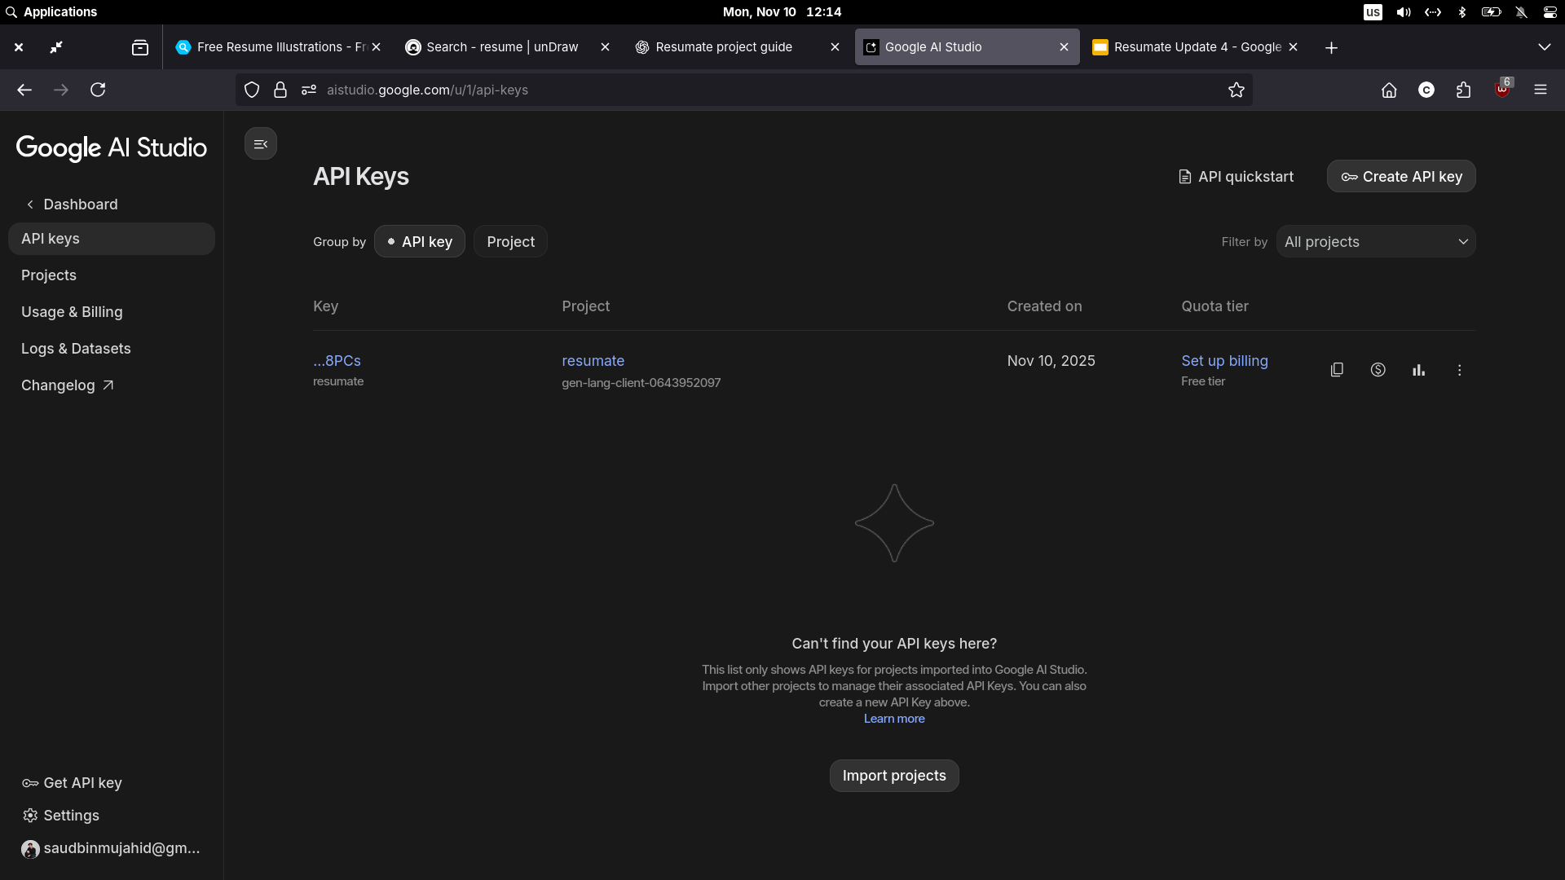
1
API creation

Slide 5
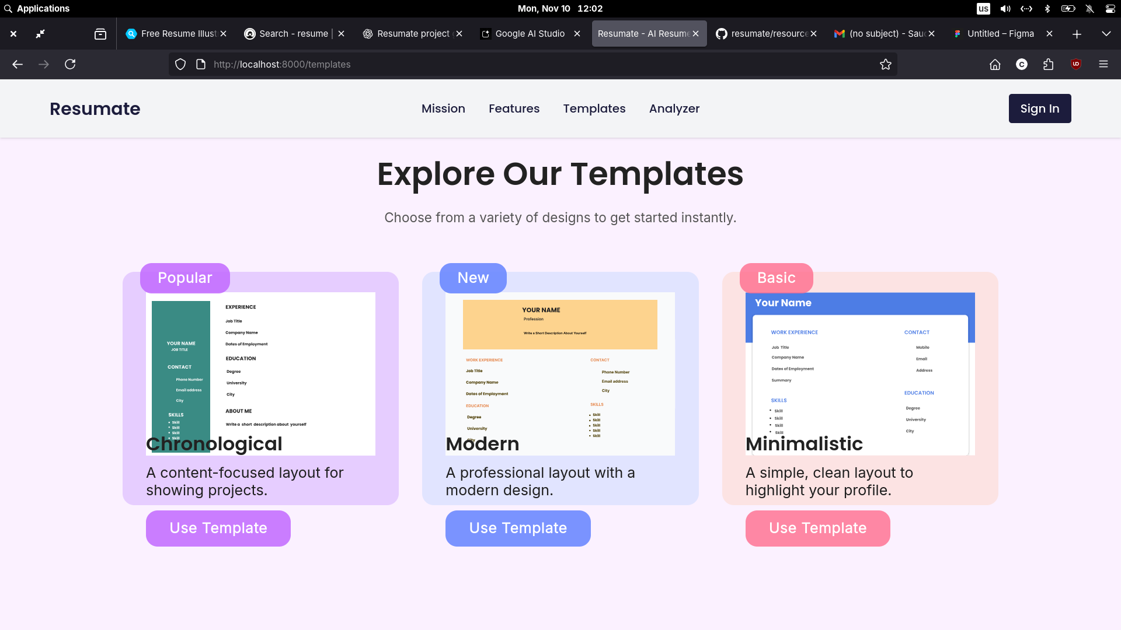
1
Templates update

Slide 6
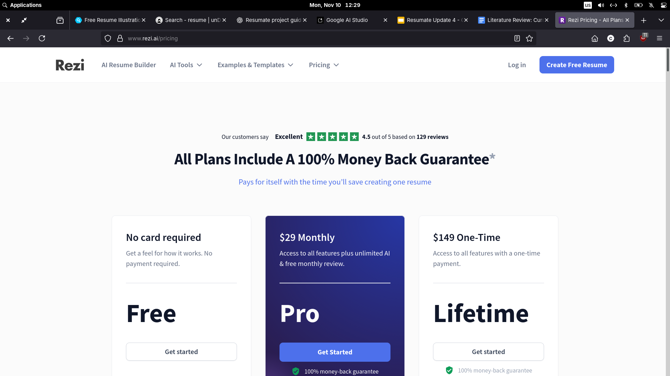
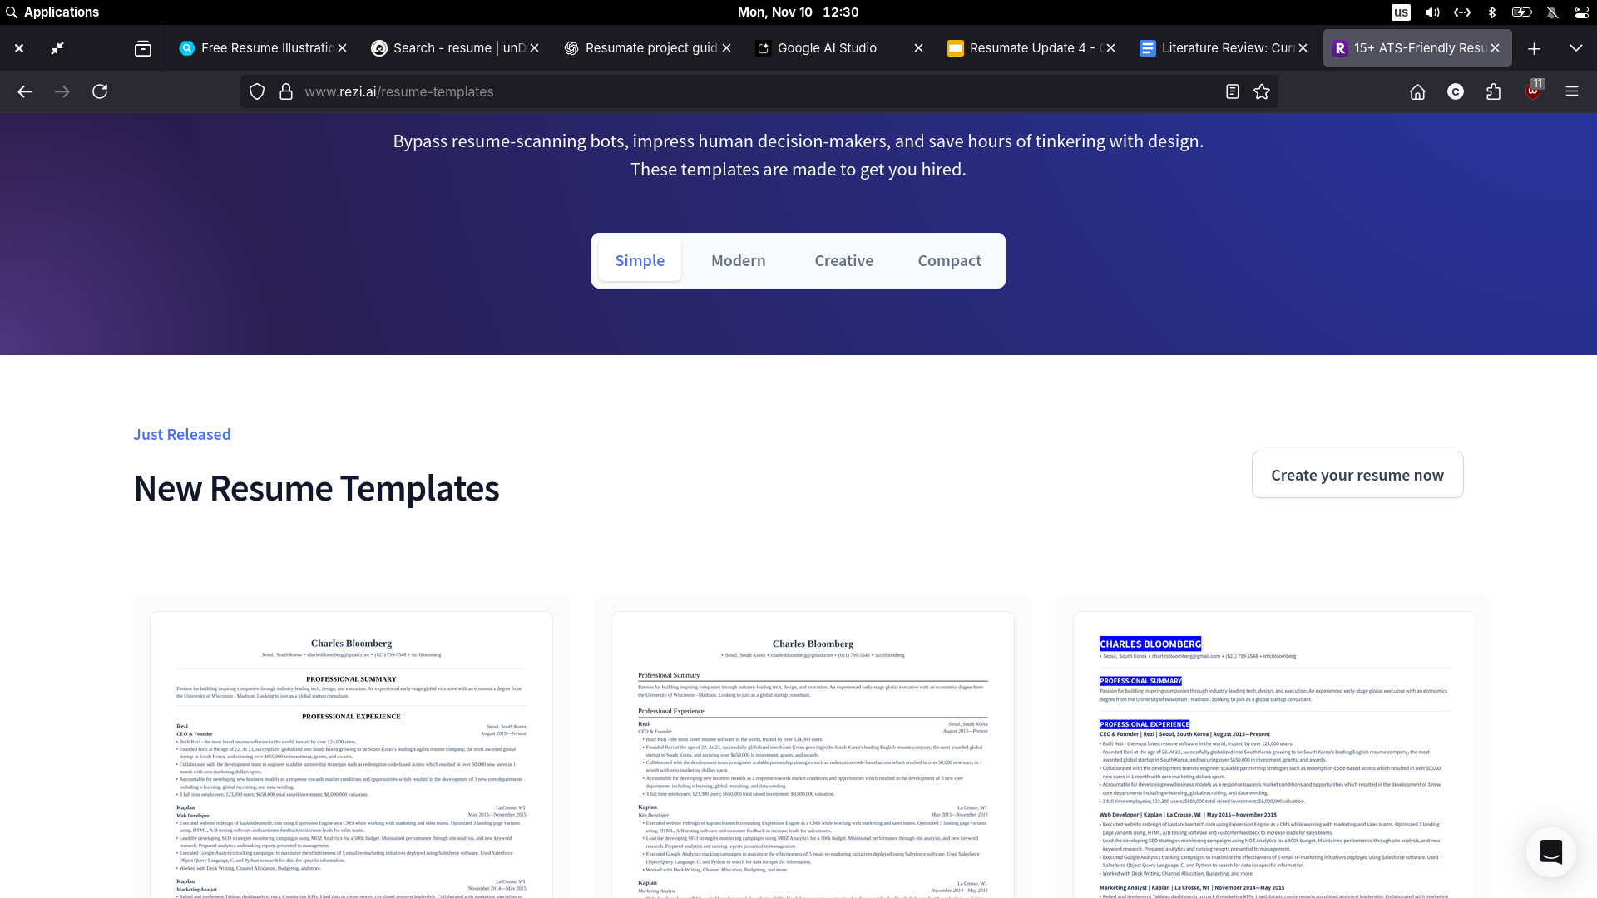
1
Rezi

Slide 7
1
Rezi
ATS Optimization: Rezi is known for its Applicant Tracking System (ATS) optimization features.
AI Scoring Algorithm: Uses a 23-point AI scoring algorithm to assess resumes.
Limited Customization: Prioritizes machine readability, which can limit user creativity and flexibility in formatting.
Rigid Formatting: Users are restricted to predefined formats, making customization difficult.
Paywall Barriers: Key features, like full resume downloads and keyword targeting, are only accessible through a paid subscription.

Slide 8
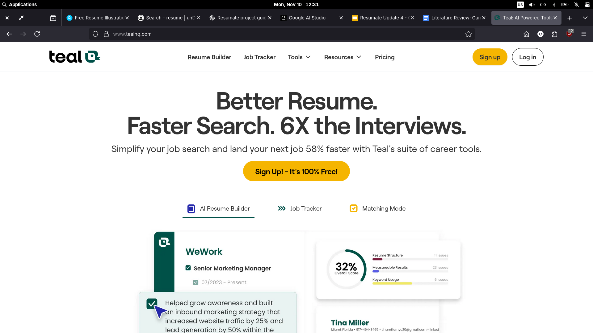
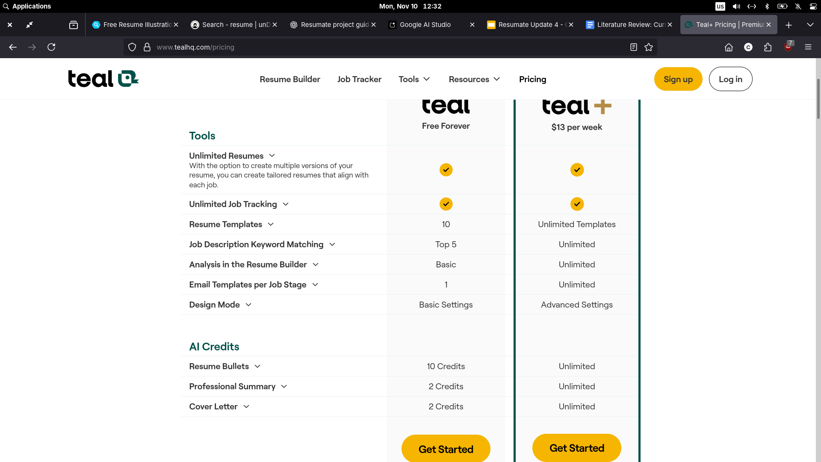
1
Teal

Slide 9
1
Teal
Job Tracking & LinkedIn Syncing: Teal offers features like job tracking and LinkedIn syncing.
AI Bullet-Point Generation: Includes an AI tool for generating resume bullet points.
Overwhelming Interface: The abundance of tools can be overwhelming, especially for first-time users looking for a simple resume builder.
Limited Templates: Basic templates lack visual appeal and customization options.
ATS Compatibility Issues: Inconsistent two-column layouts may cause ATS compatibility problems.
Upselling of Premium Features: Frequent promotion of paid features detracts from the overall user experience.

Slide 10
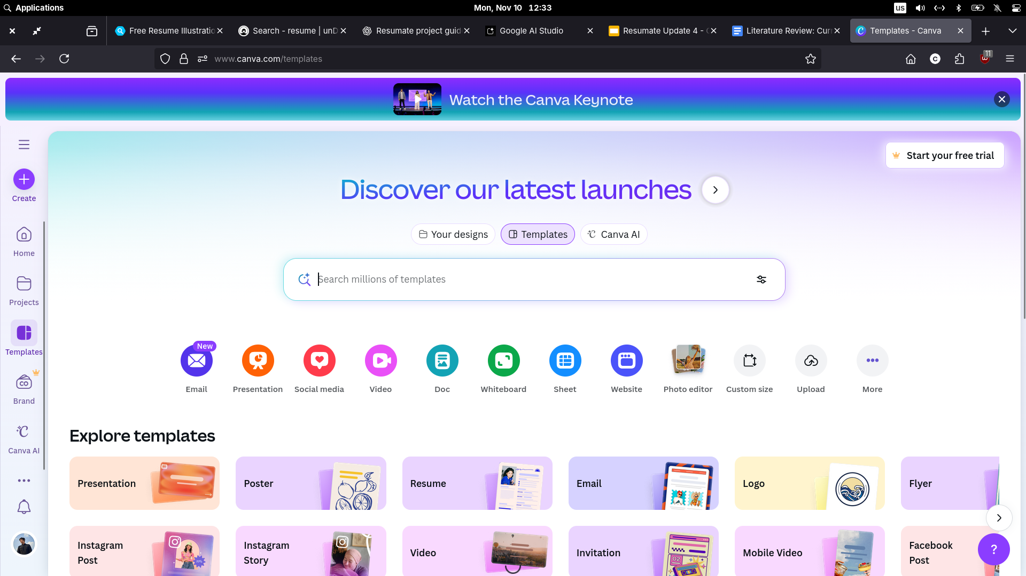
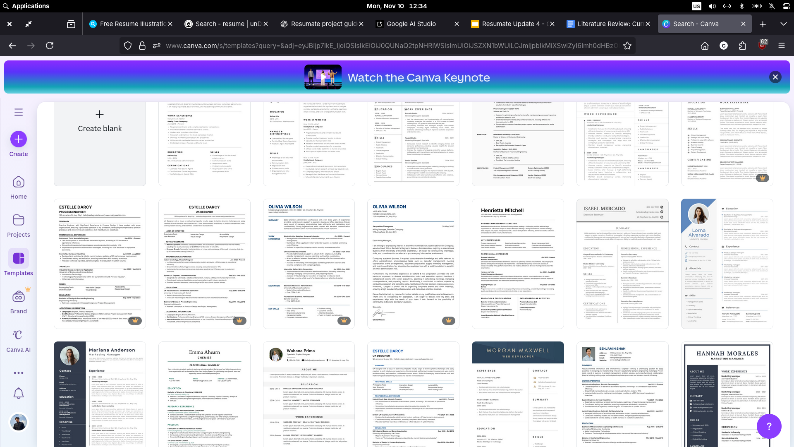
1
Canva

Slide 11
1
Canva
Design Flexibility: Canva is popular for its design versatility but suffers from feature overload.
Embedded in a Vast Ecosystem: Resume tools are part of a larger design platform, making it less intuitive for users seeking a quick, professional document.
Overwhelming Customization: The abundance of options, widgets, and templates can overwhelm less tech-savvy users.
Complex Process: What should be a straightforward task becomes a more complex design project due to the range of choices available.

Slide 12
1
Resumate
Focus on Simplicity and Transparency: Resumate prioritizes an intuitive, minimal interface dedicated solely to resume creation.
Free Essential Features: Core functions like AI text generation, editing, and PDF export will remain free and accessible, especially for students and early-career users.
No Unnecessary Distractions: Unlike other platforms, Resumate avoids job tracking or unrelated integrations, keeping the user experience focused.
Peer & Recruiter Feedback Loop: Integrates a machine learning-powered feedback system, gathering insights from real-world hiring data.
ATS-Friendly and Visually Appealing: Helps users create resumes that are both ATS-optimized and visually attractive.
Actionable Insights: Provides meaningful feedback on how to improve resumes, beyond just formatting and keywords.
Affordable & Personalized: Aims to address the gaps in usability, affordability, and personalization seen in existing AI resume builders.
Community-Driven Evaluation: Incorporates real-world feedback to make resume creation more effective and approachable for users at all career stages.

Slide 13
1
What is next?

Slide 14
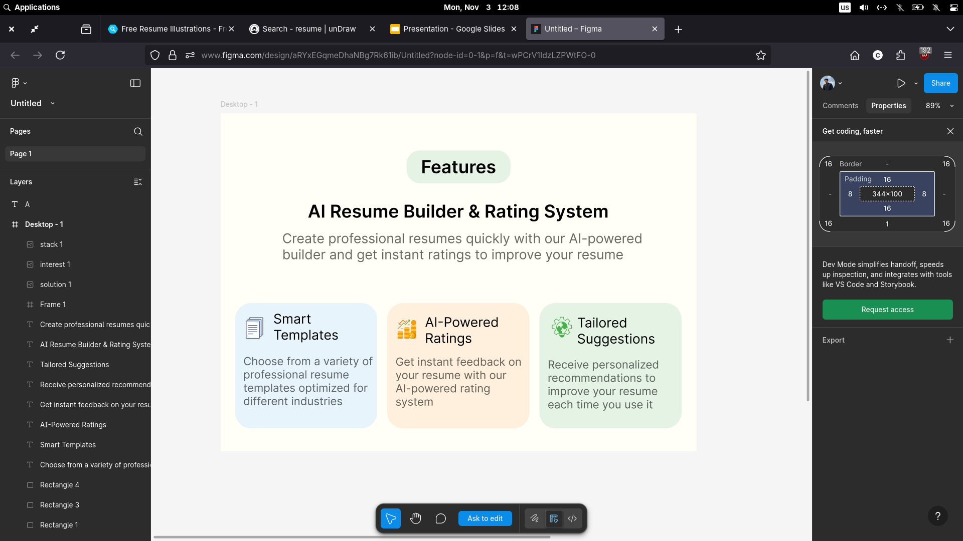
1
Figma

Slide 15
Thank You

